Slide 1



DATA ANALYST PROJECT ON
The Data of Democracy
A Statistical Portrait of Power in Maharashtra
Presented By
Ganeshraj Patil

Slide 2


Data Resourse
Total Candidate Data=”https://www.myneta.info/Maharashtra2024/index.php?action=summary&subAction=candidates_analyzed&sort=candidate#summary”
Winners Candidate Data=”https://www.myneta.info/Maharashtra2024/index.php?action=summary&subAction=winner_analyzed&sort=candidate#summary”
Maharashtra Assembly Result Wikipedia=”https://en.wikipedia.org/wiki/2024_Maharashtra_Legislative_Assembly_election”

Slide 3
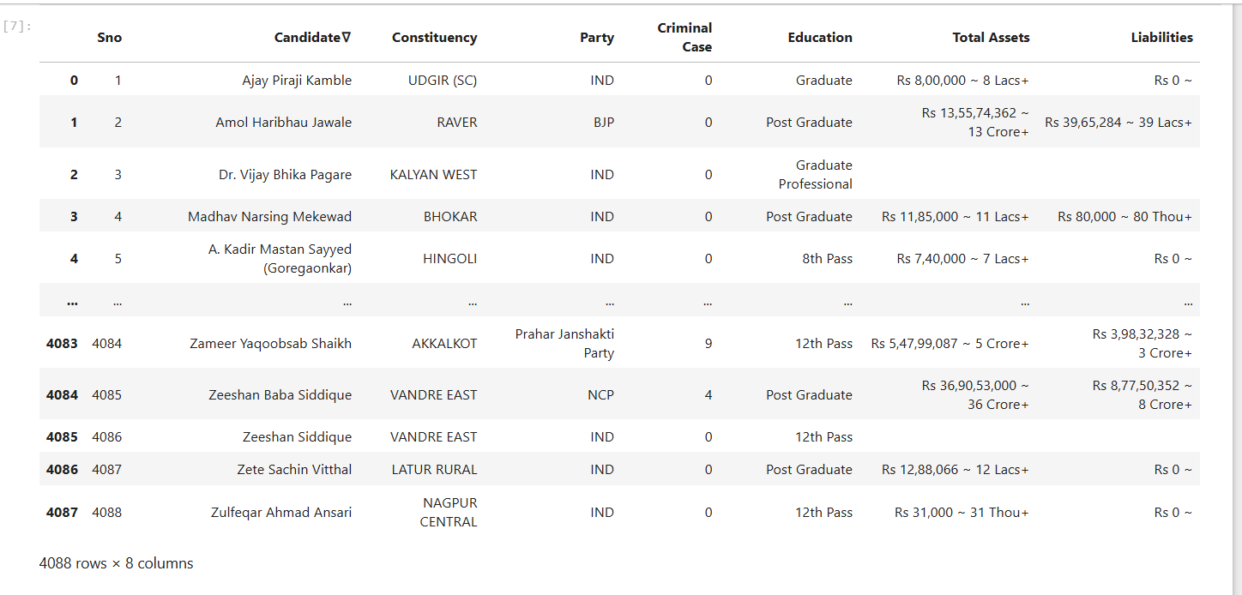
TOTAL CANDIDATE DATA, AFTER SCRAPPING FROM THE SITE

Slide 4
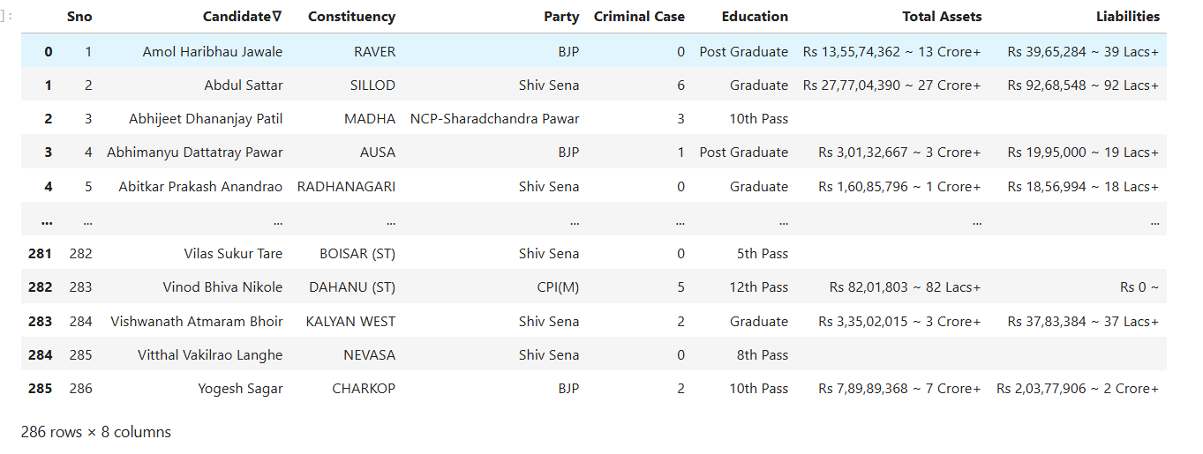
WINNERS DATA AFTER SCRAPPING

Slide 5
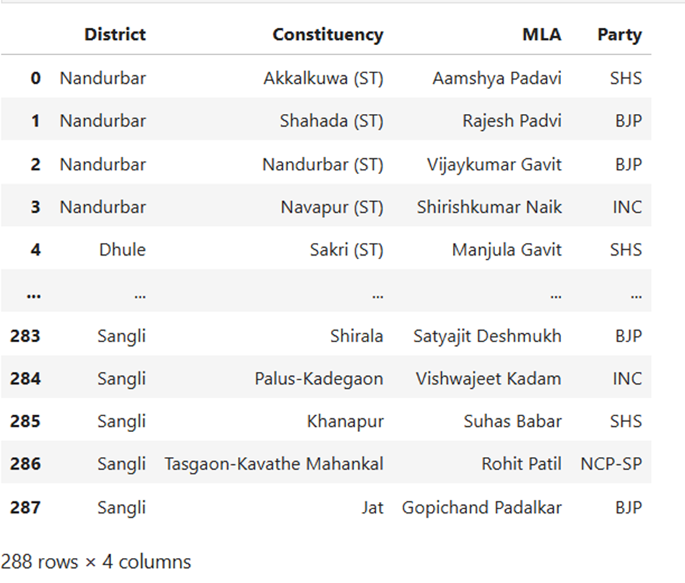
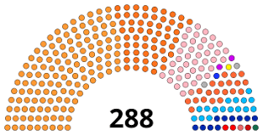
MAHARSHTRA LEGISLATIVE ELECTION RESULT FROM WIKIPEDIA

Slide 6
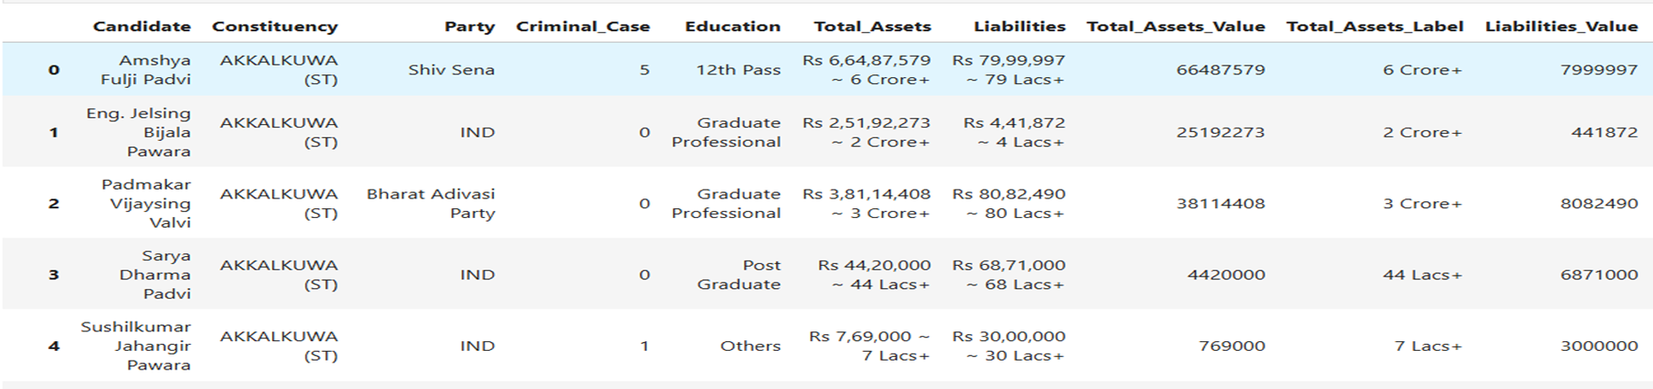
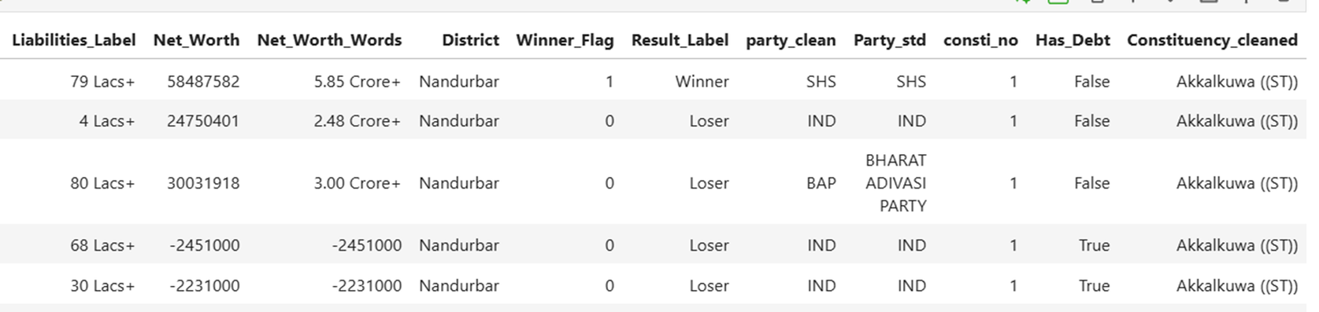
Data After Processing EDA

Slide 7
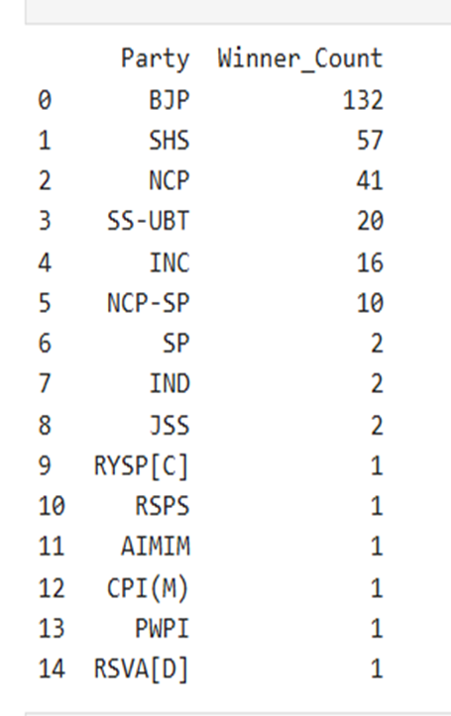
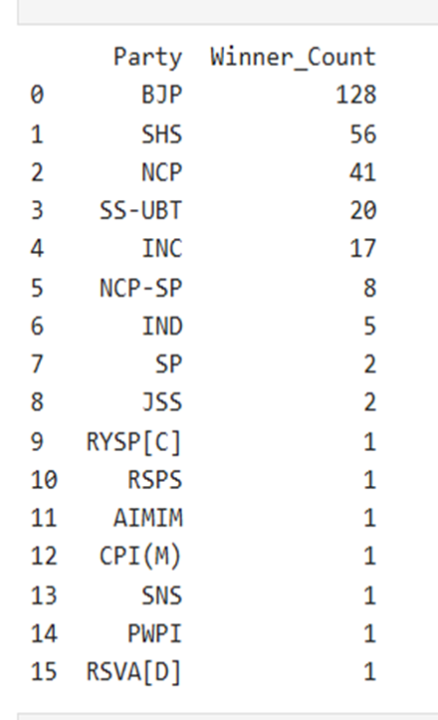

Result Difference Between Wikipedia Data and Scraped Data
Wikipedia Result
(Official Result Of Election Commision Of India)
Result From Scrapped Data

Slide 8
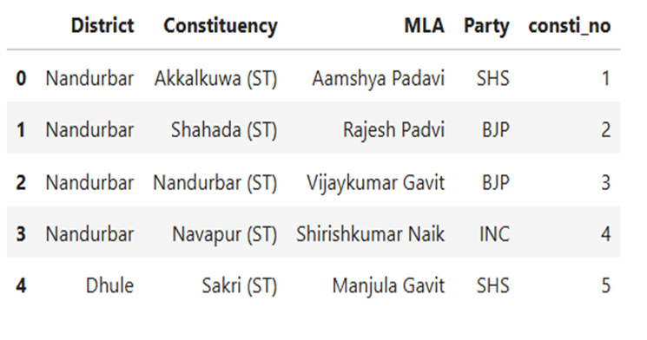

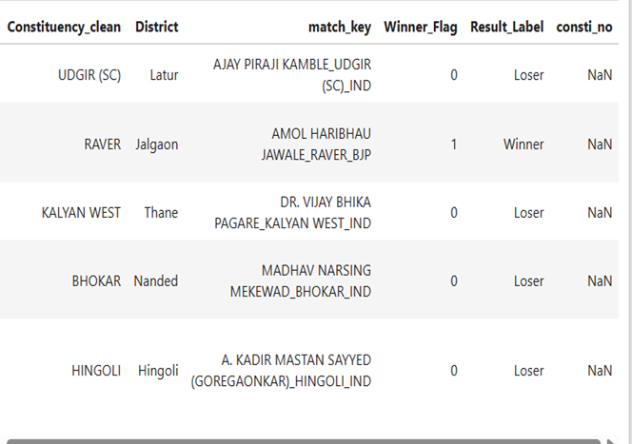
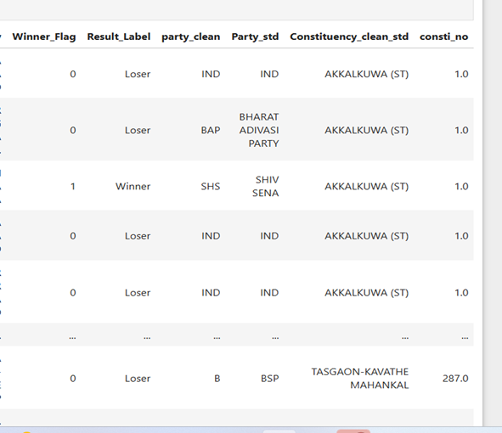

Slide 9
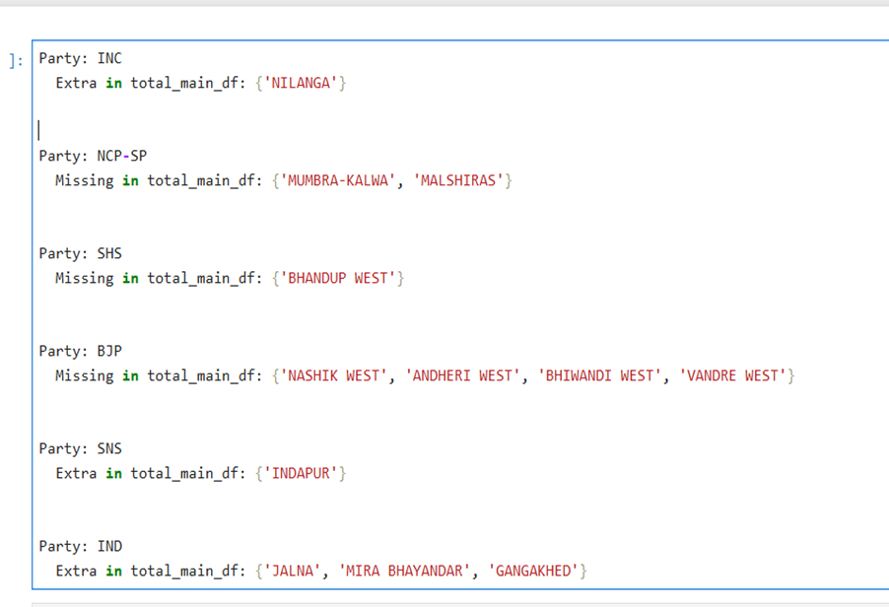
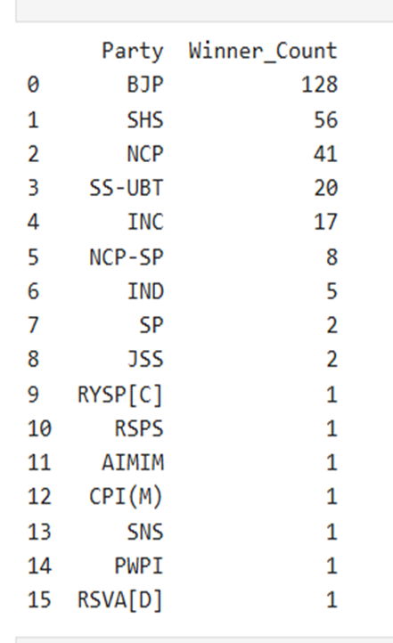

Slide 10
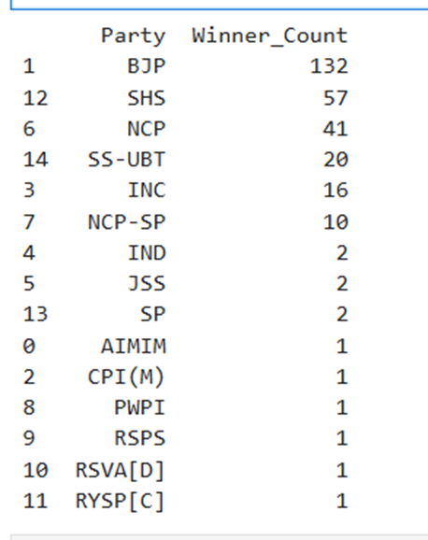

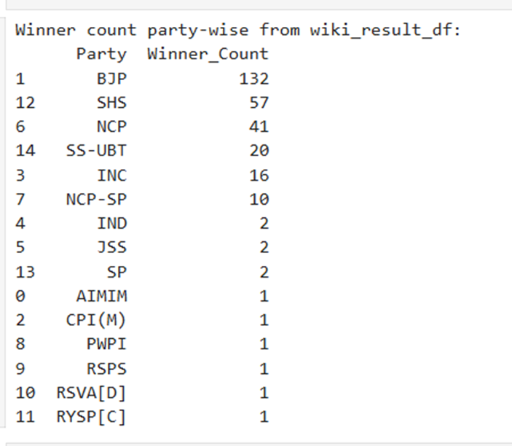
This is the final result After Applying EDA
This is From Scrapped Data
This is the Actual Result

Slide 11
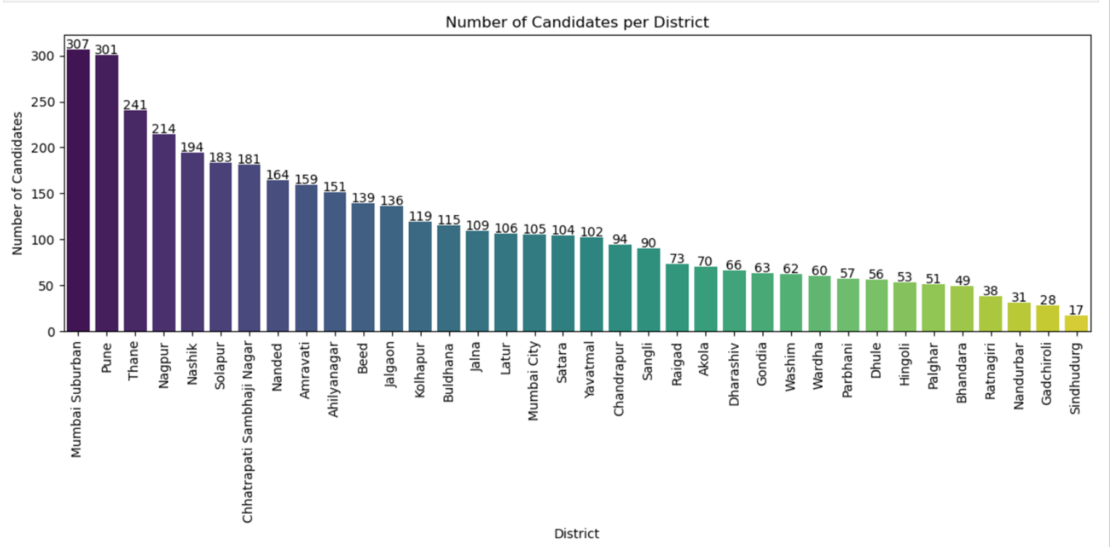
Number Of Candidates Per District

Slide 12
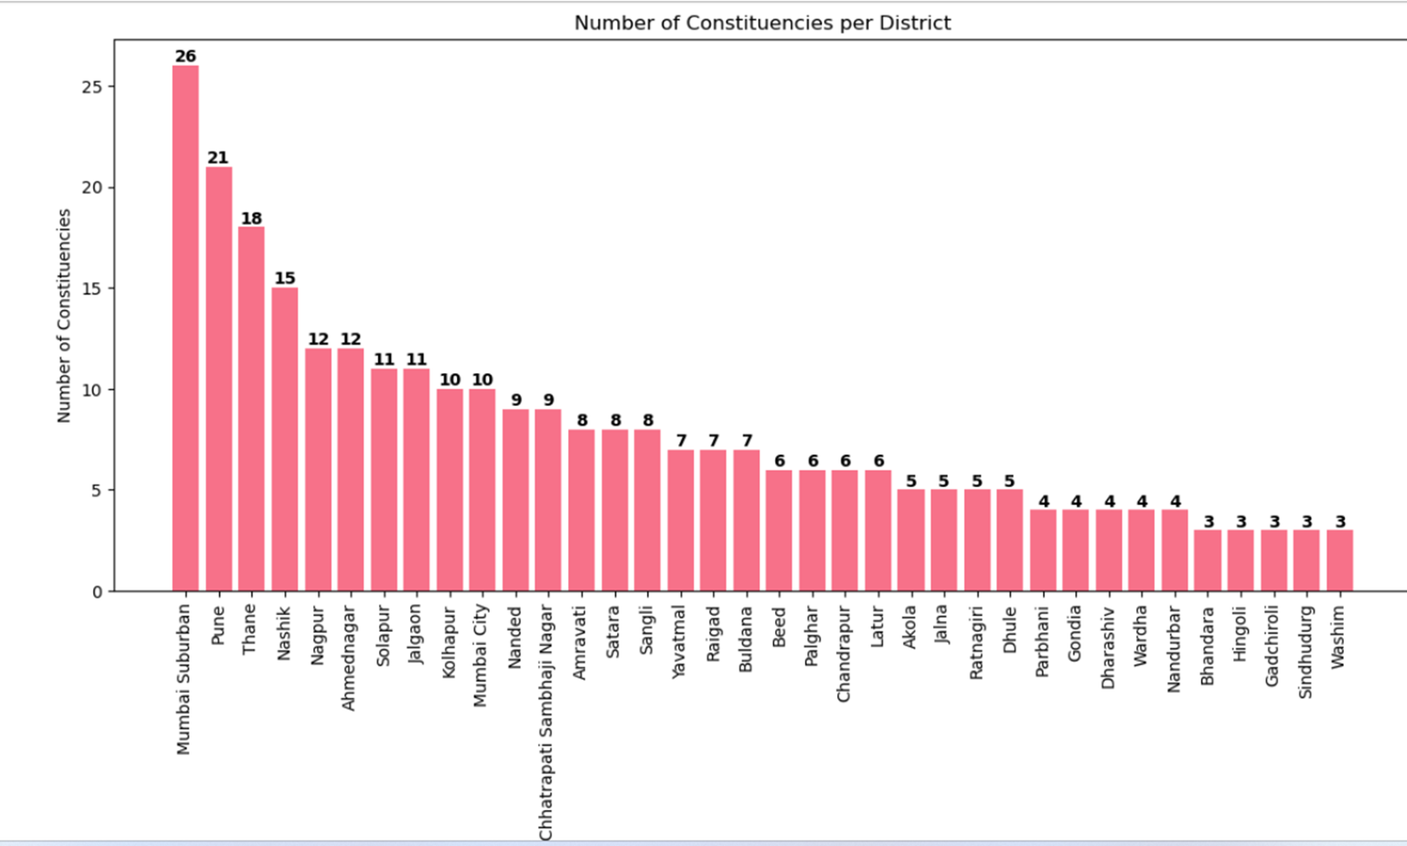
Number Of Constituncies By District

Slide 13
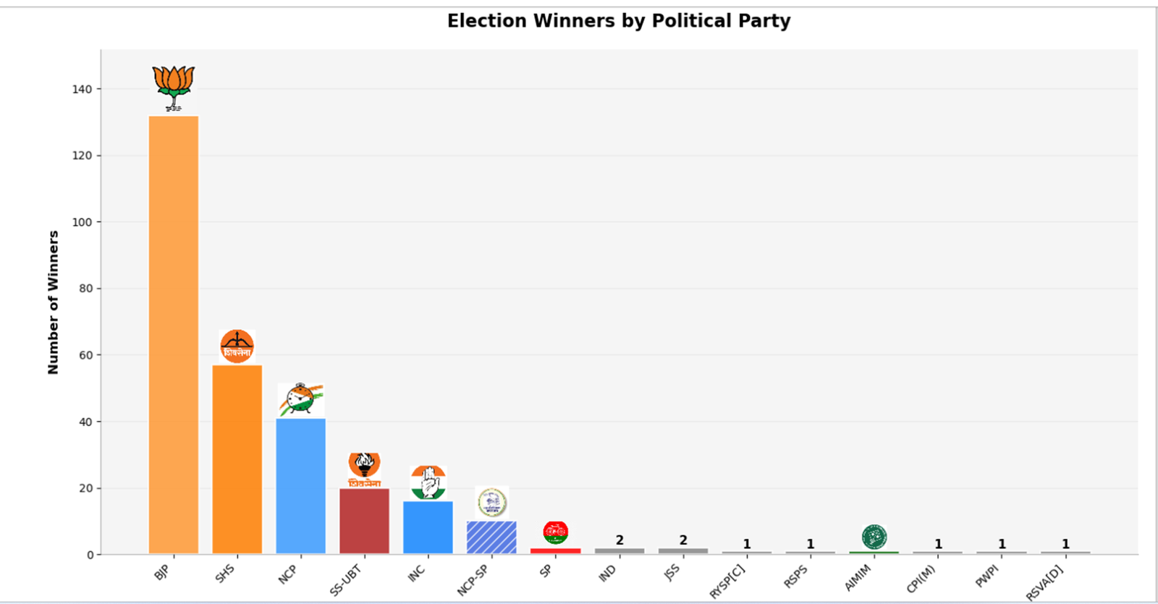
Election Winners By Party (Election Result)

Slide 14
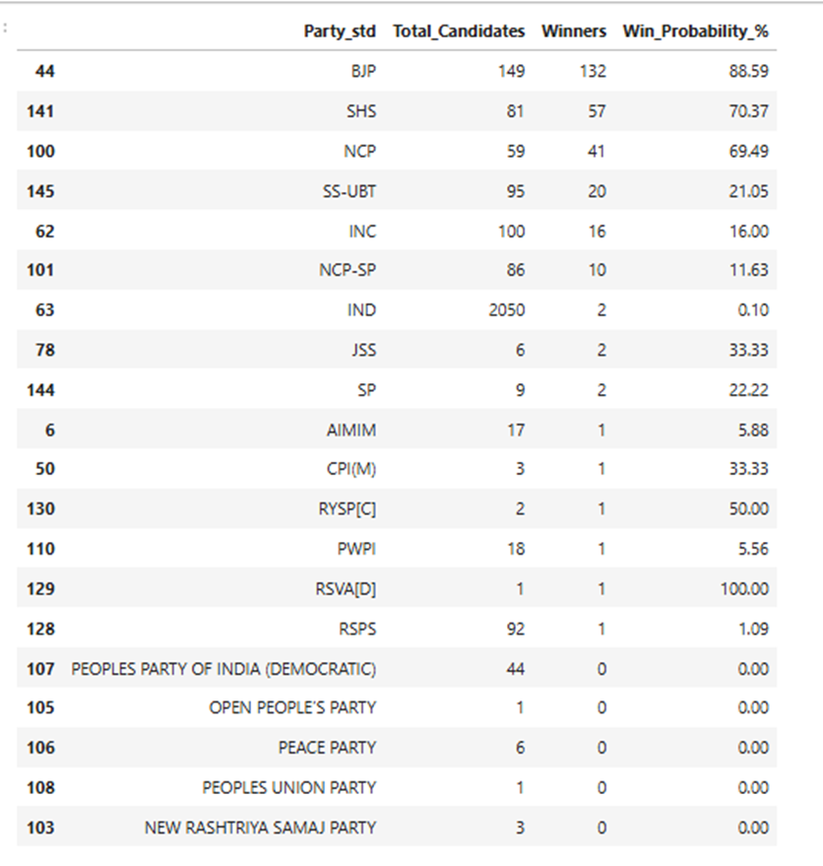

Slide 15
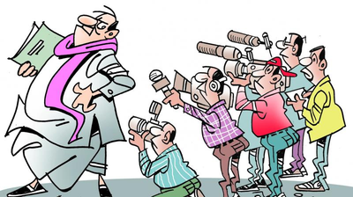
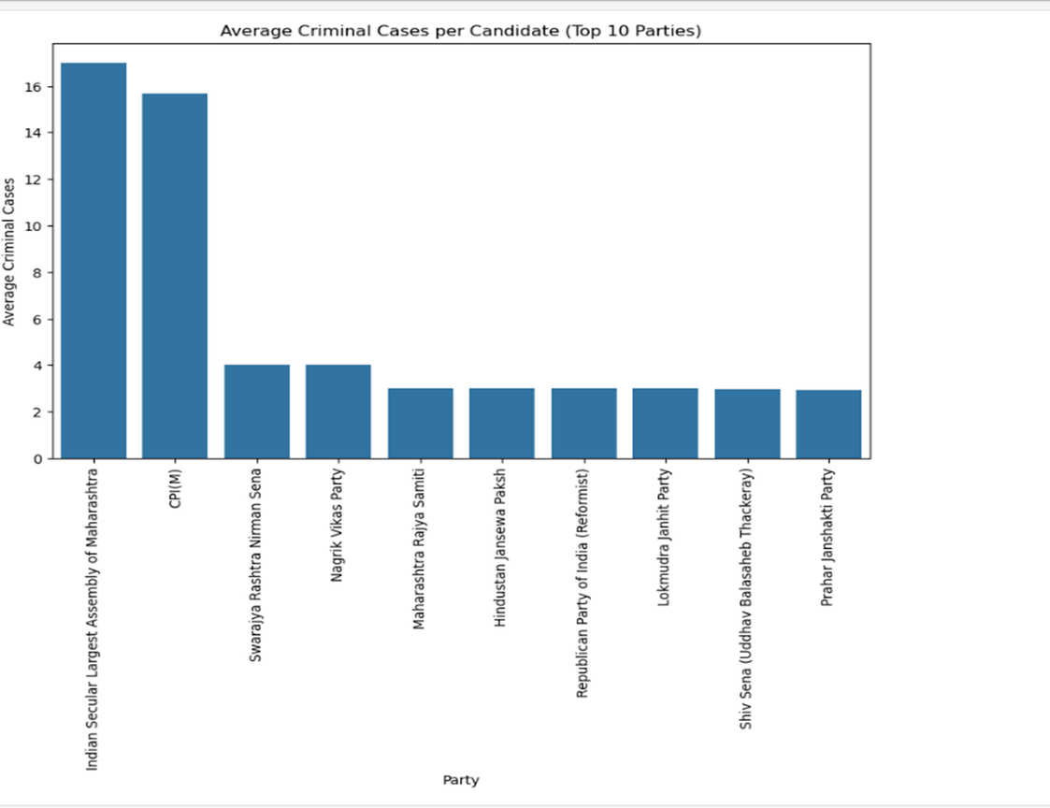
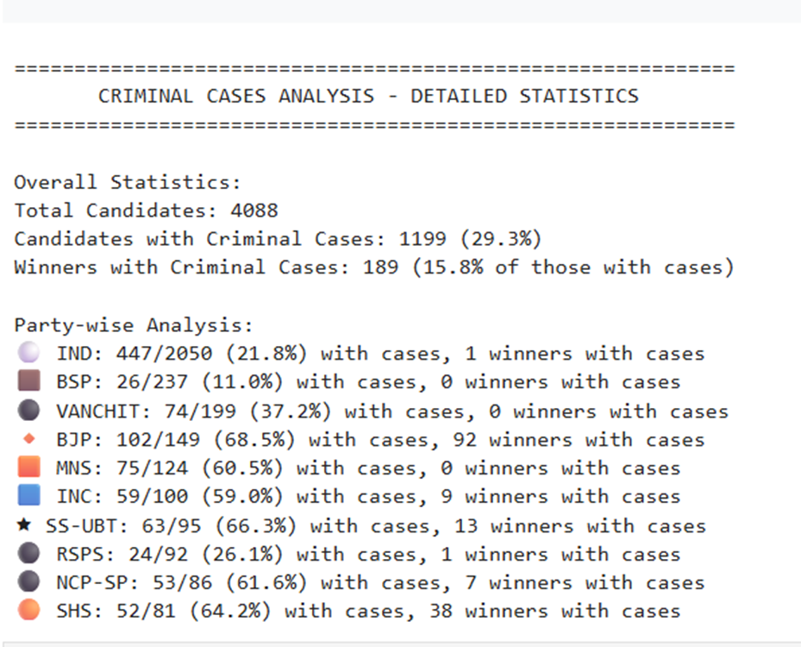
Average Criminal Cases Per Candidate ((Top 10 Parties)

Slide 16
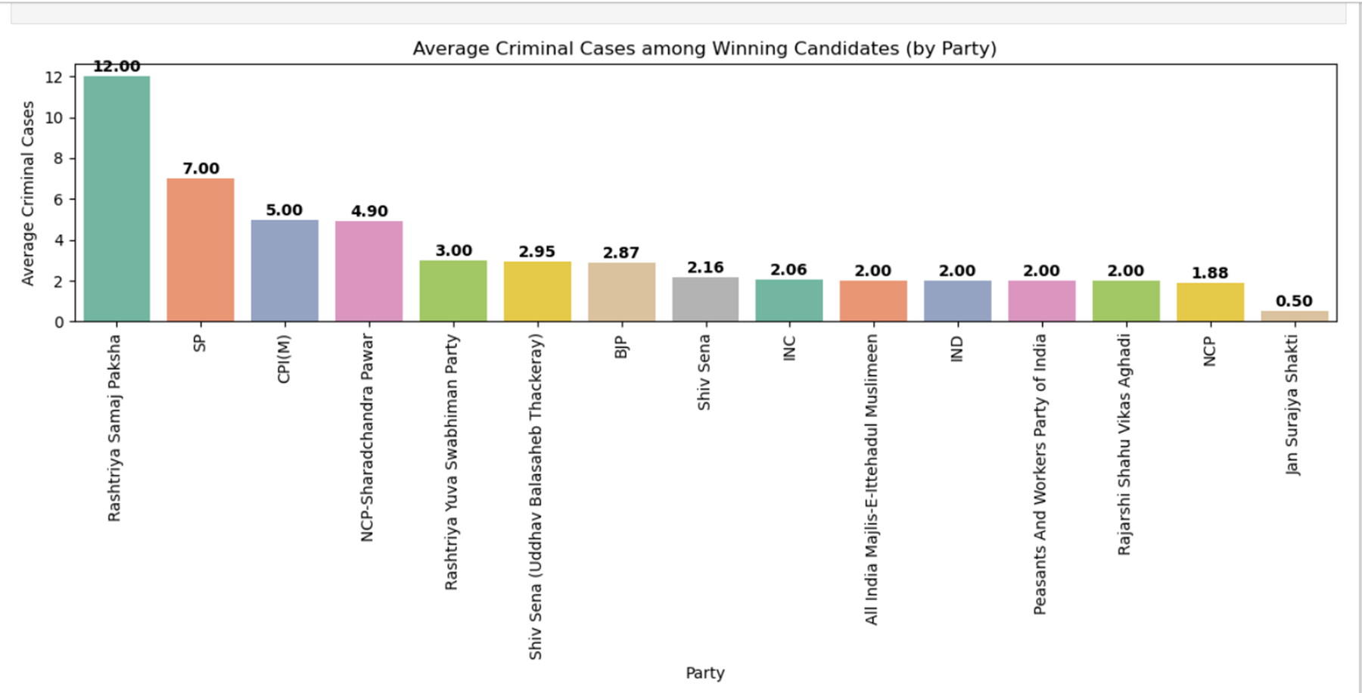
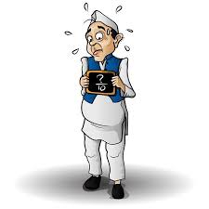
Average Criminal Cases Among Winning (By Party)

Slide 17
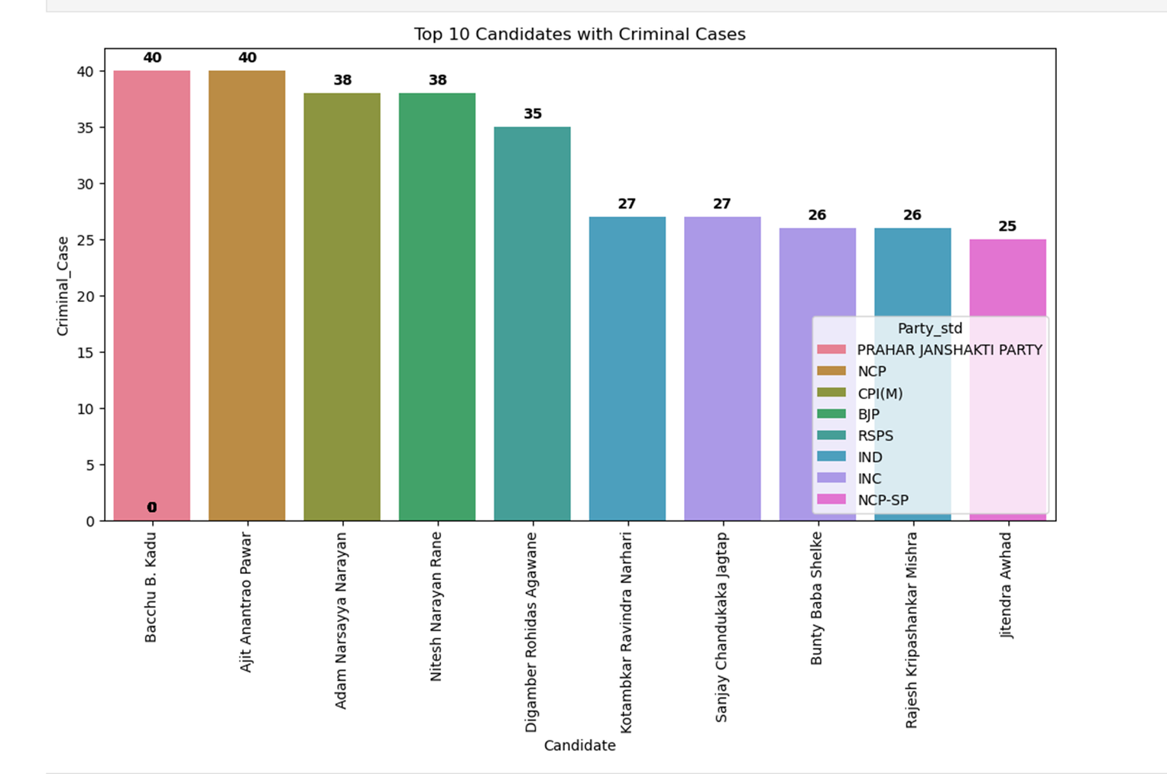
Top 10 Candidates with criminal Cases with party

Slide 18
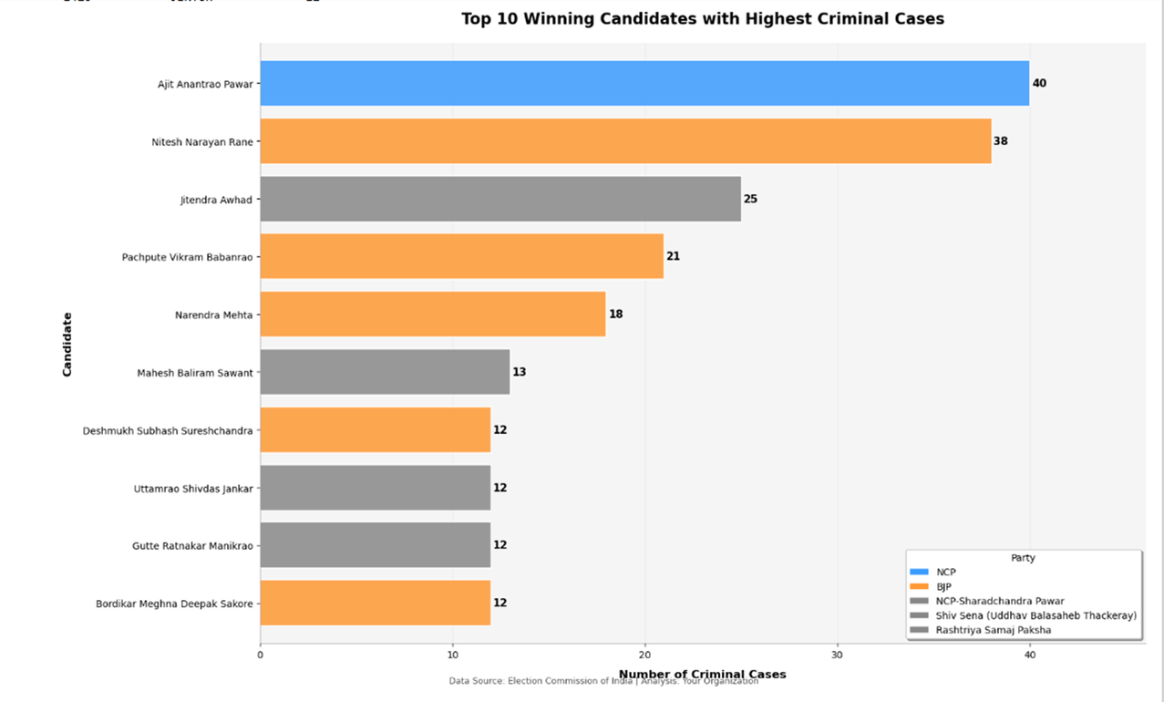
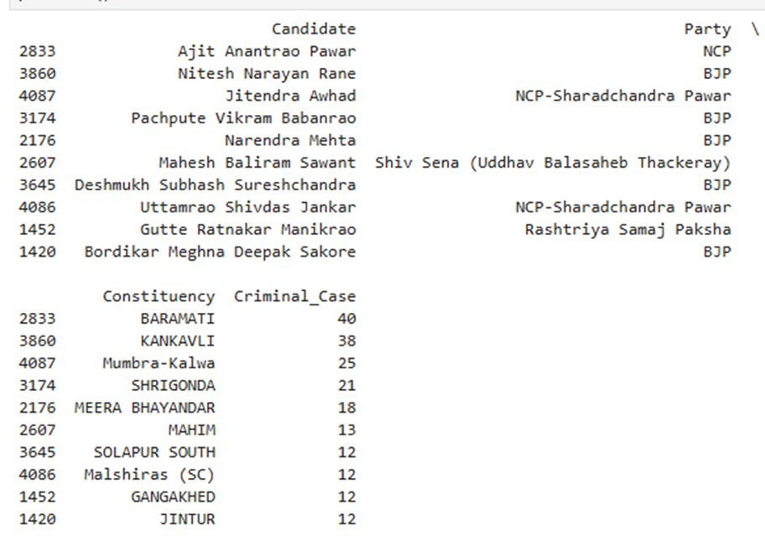
Top 10 Winning Candidates with highest Criiminal Cases

Slide 19
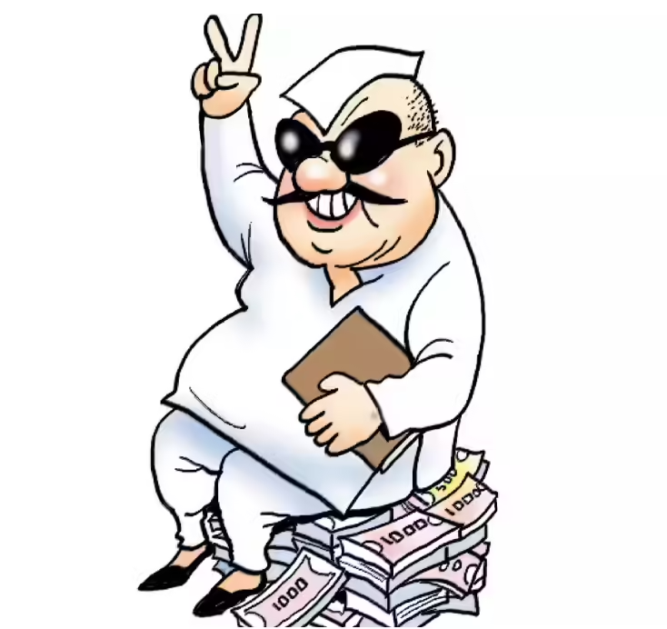
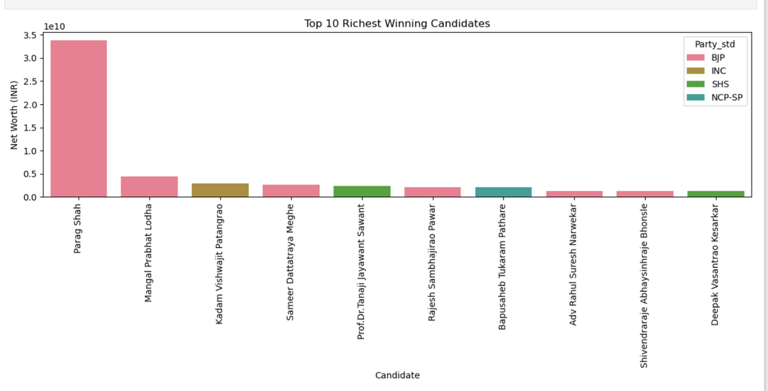
Top 10 Richest Winning Candidates

Slide 20
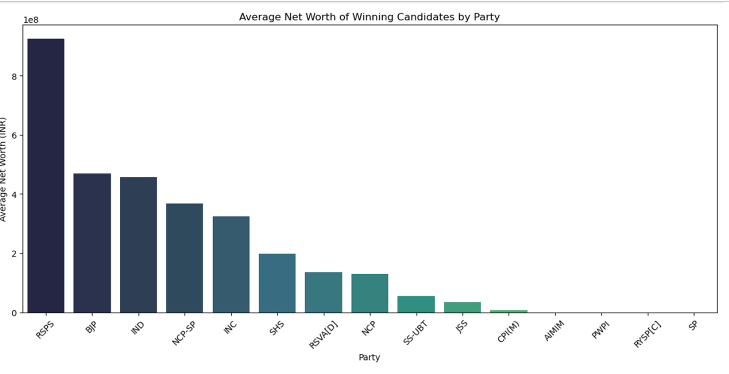
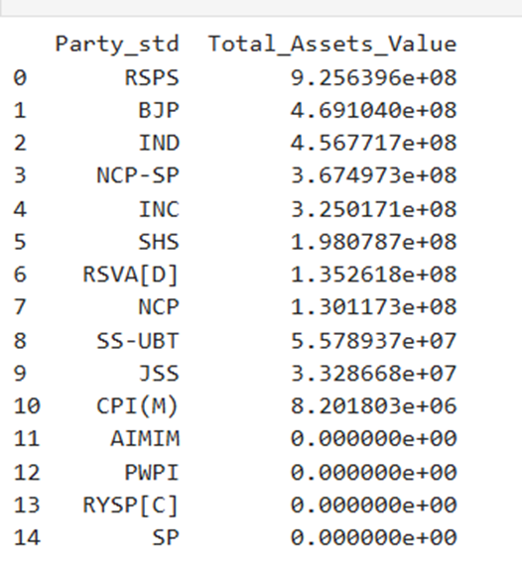
Average Net Worth Of Winning Candidates By Party

Slide 21
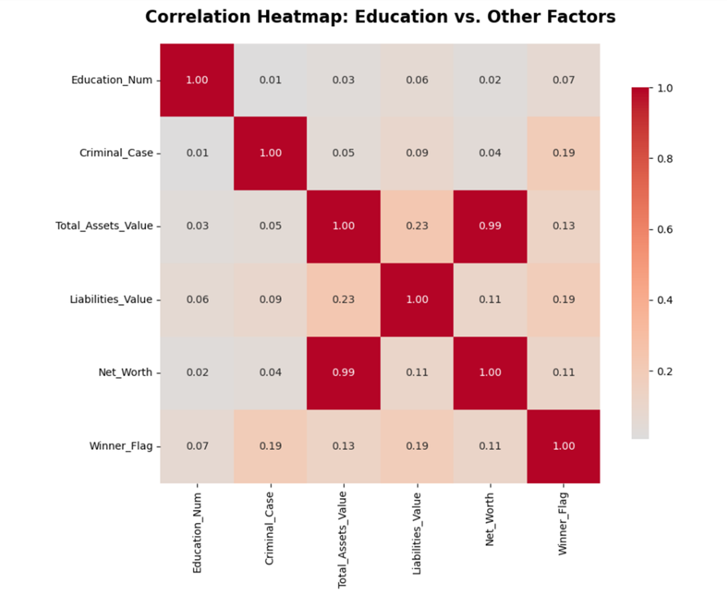
Education vs Other Factors

Slide 22
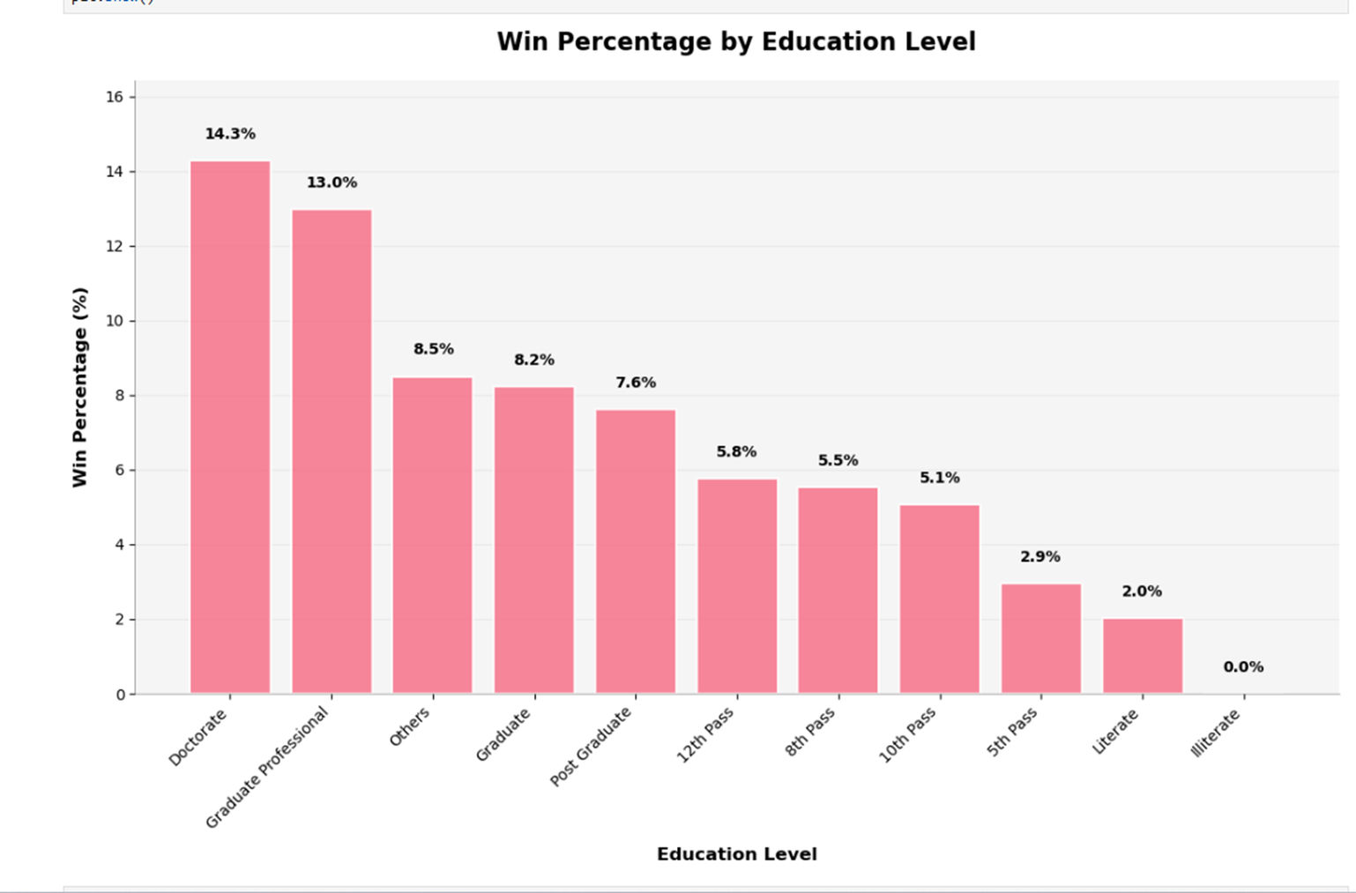
Win Percentage by Education Level

Slide 23
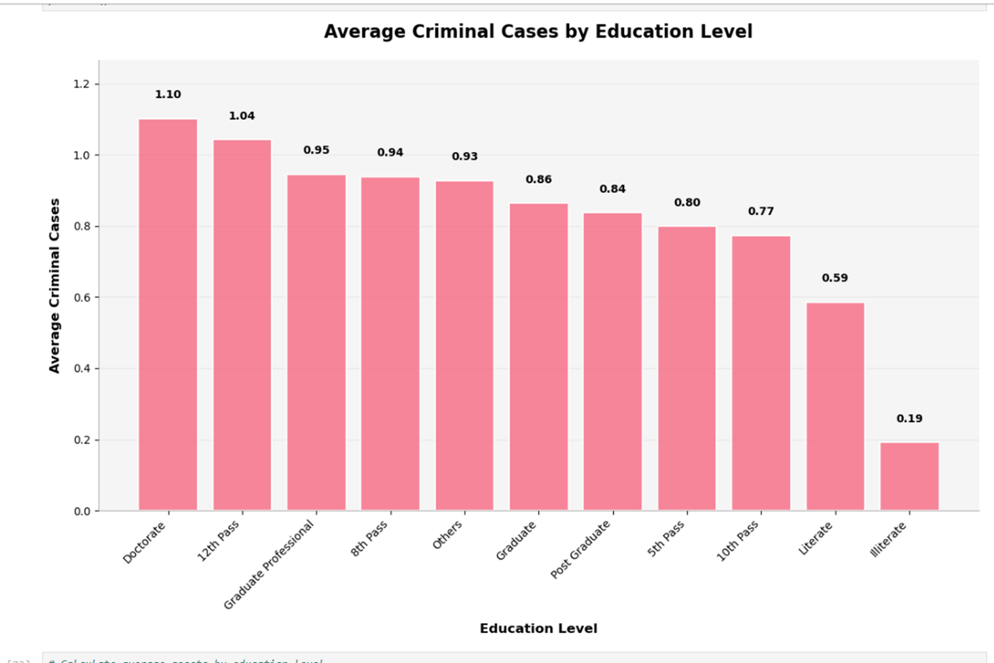
Average Criminal Cases By Education Level

Slide 24
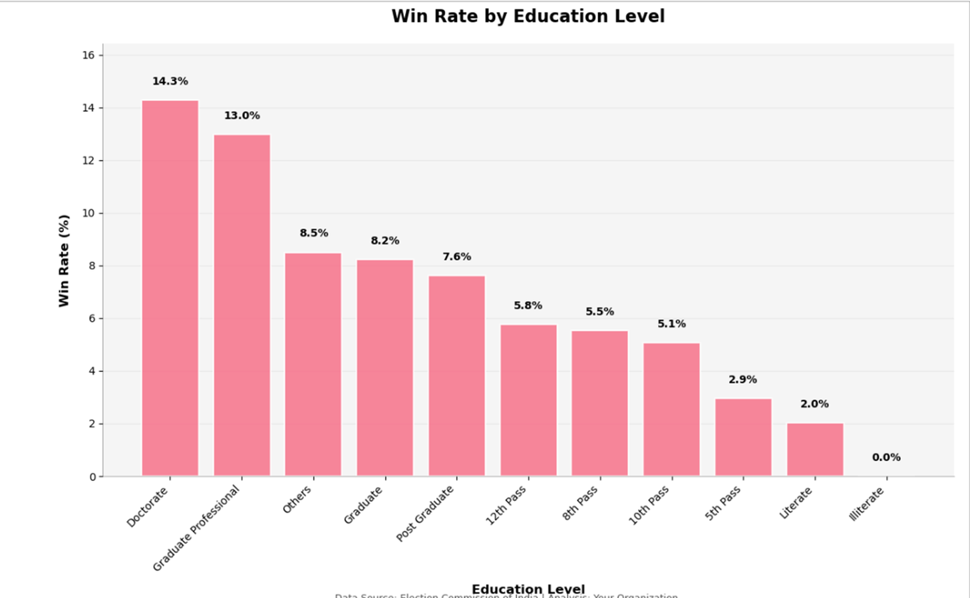
Win Rate By Education Level

Slide 25
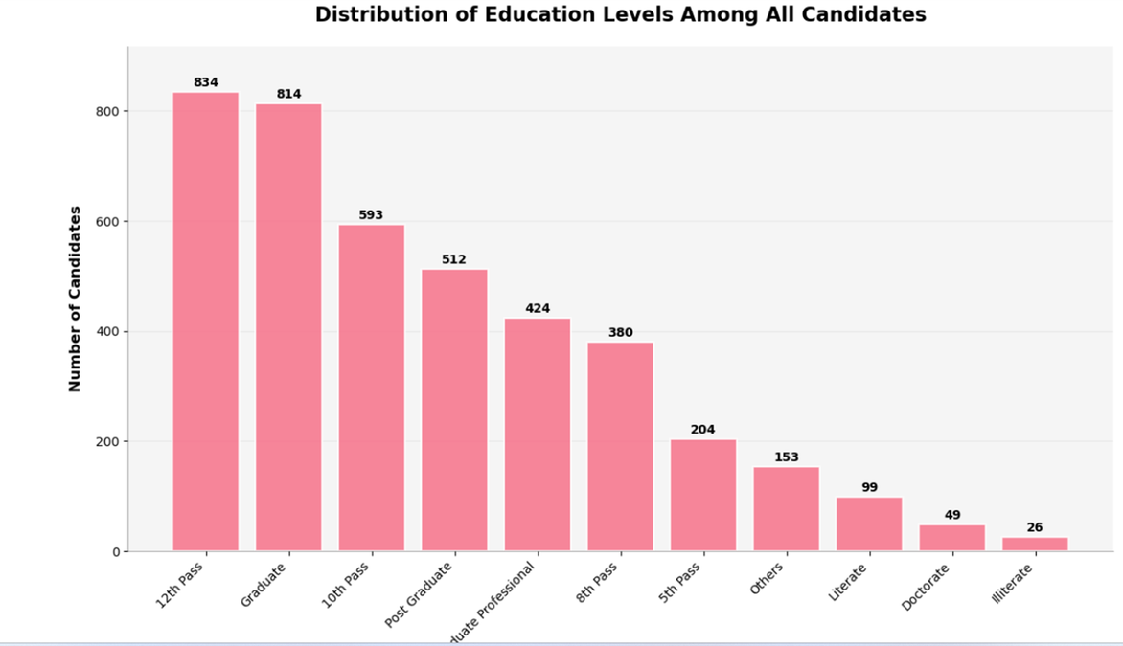
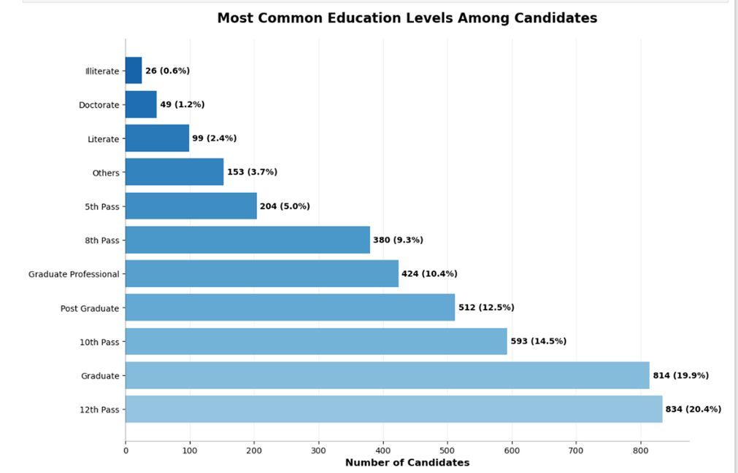
Distribution Of Education Levels Among All Candidates

Slide 26
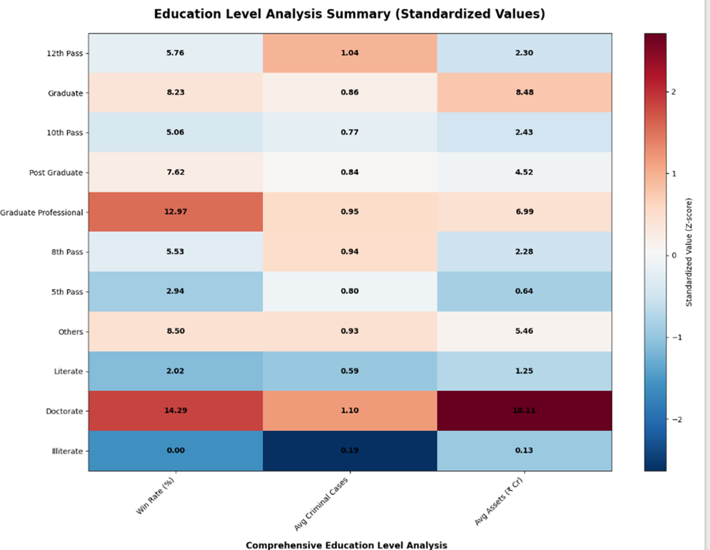
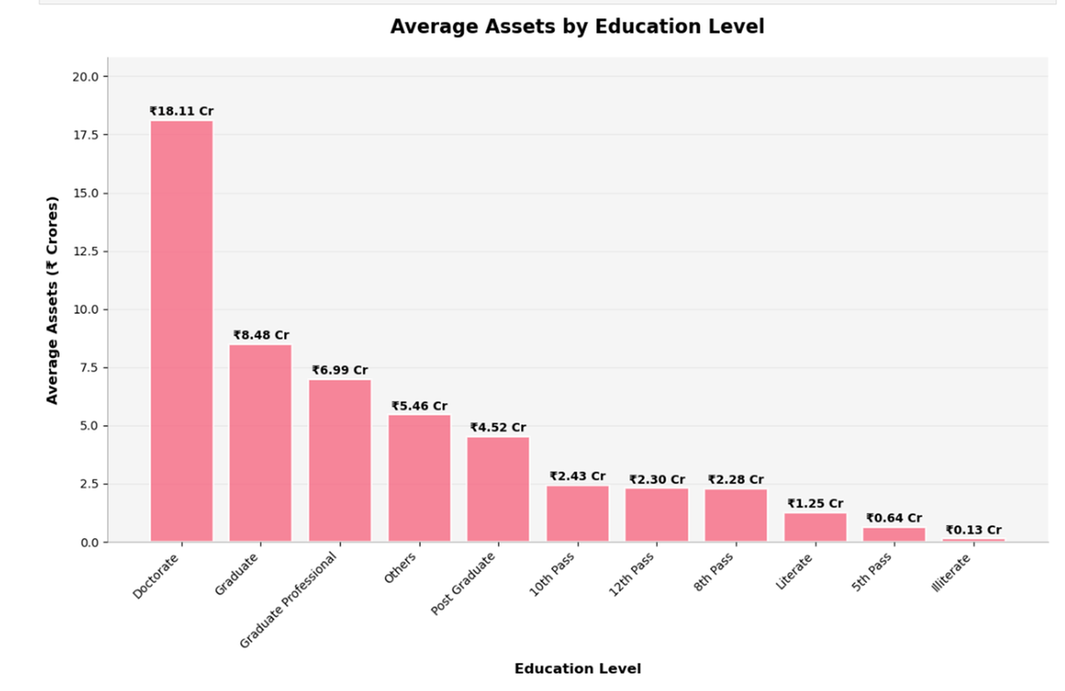
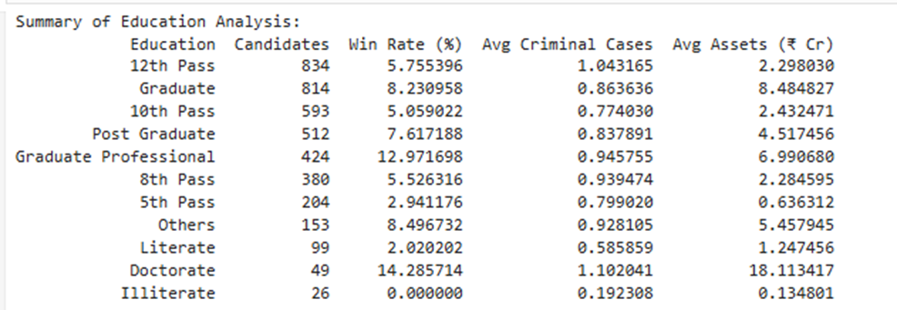
Summary Of Education Analysis

Slide 27
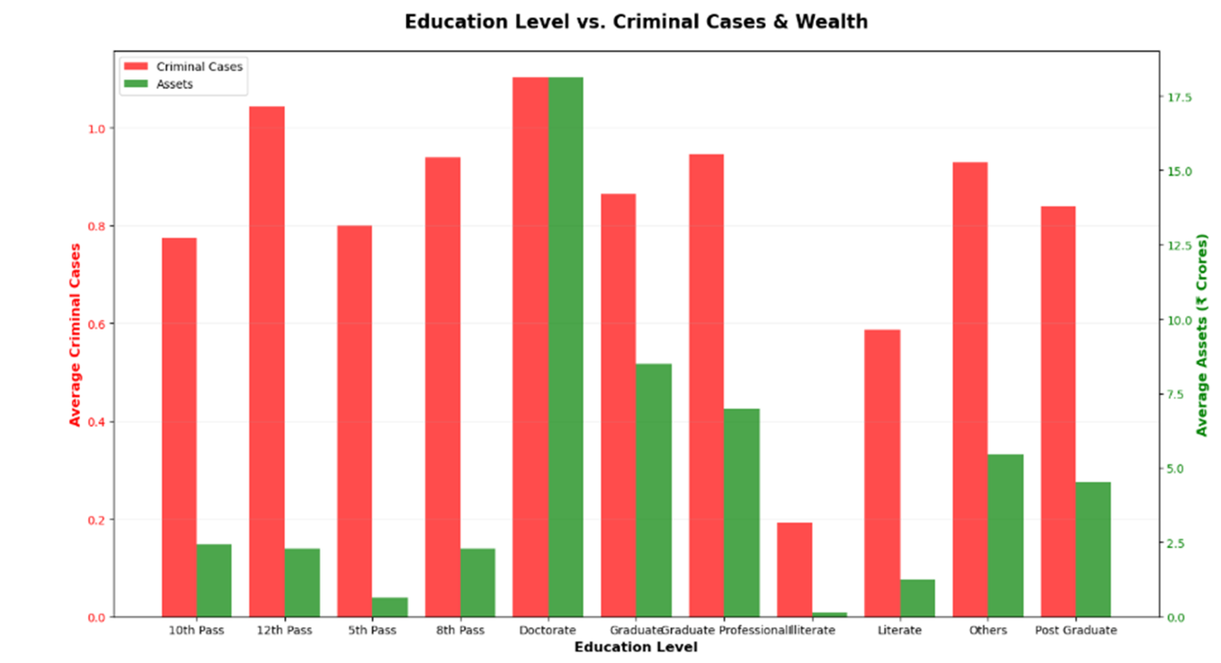
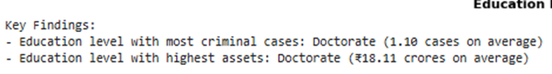
Education Levels vs Criminal Cases And Wealth

Slide 28
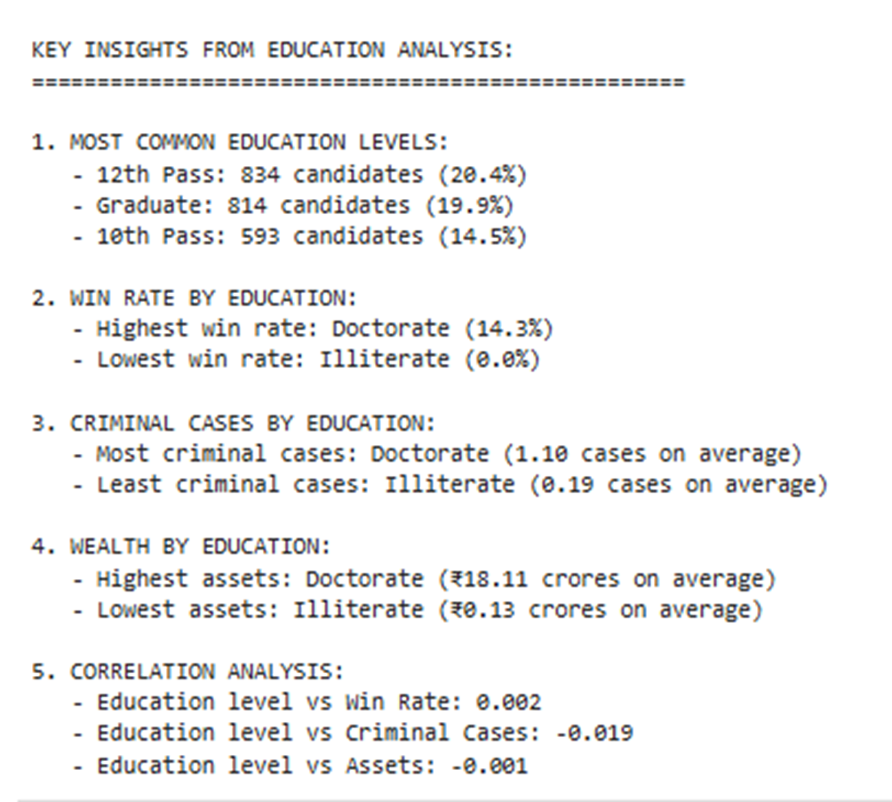
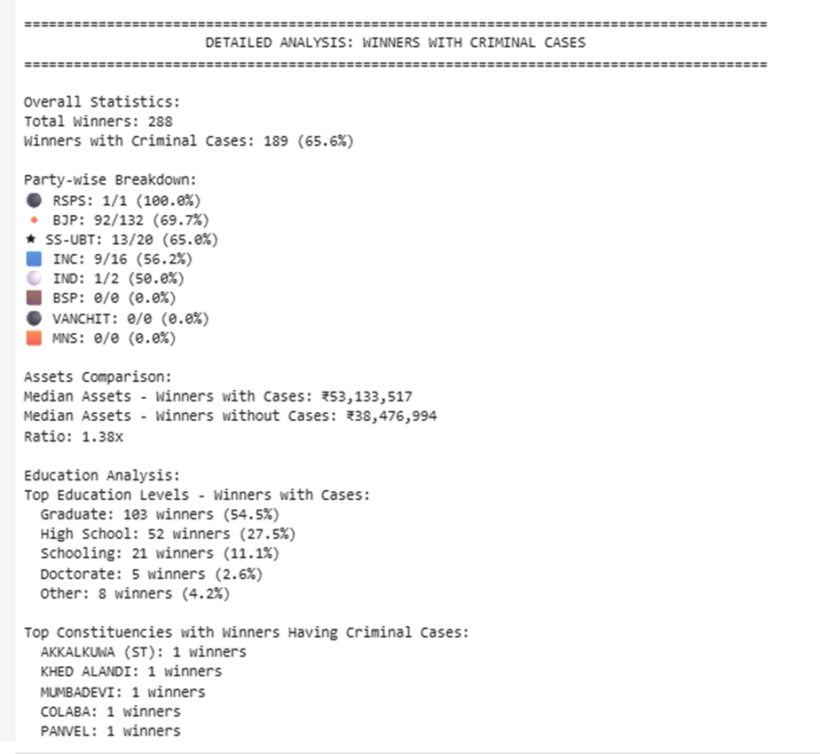
Final Analysis

Slide 29

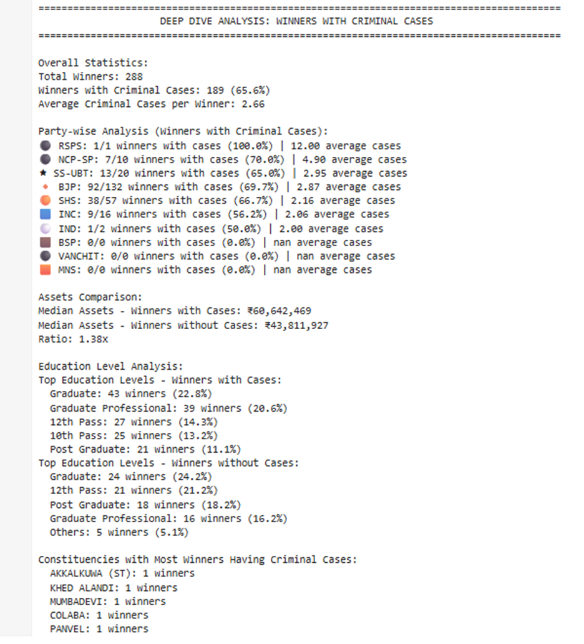
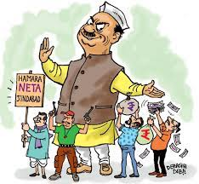

Slide 30
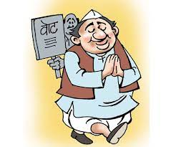

Thank
you!

Slide 31




Thank
you!

